Slide 1
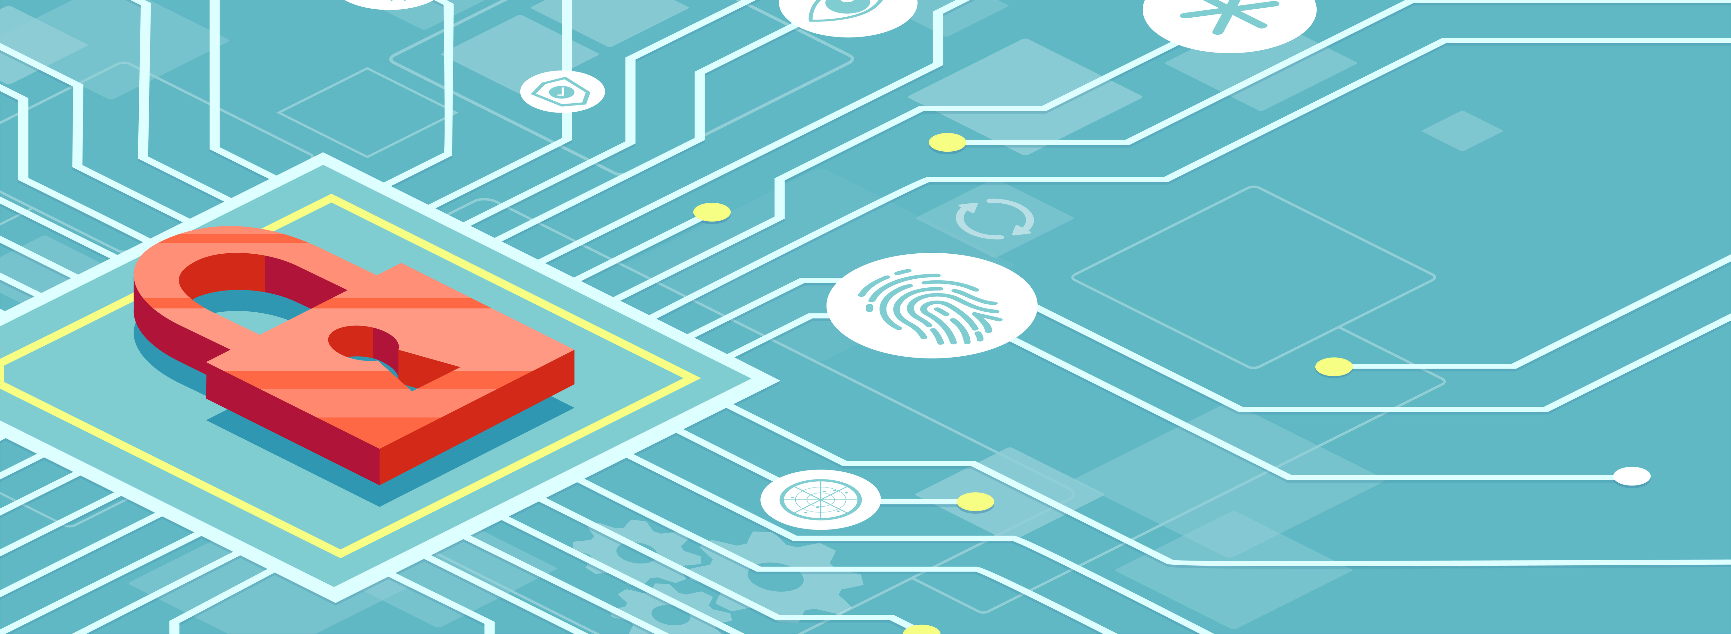
Unmasking Forms
Finding the Balance Between Accessibility and Security
Notes:
Richard to start

Slide 2
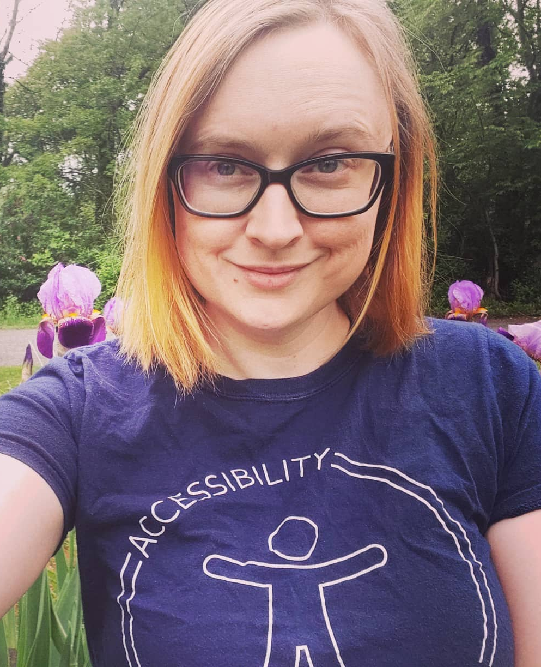

The Presenters
Tori
Clark
Richard Steinberg
Notes:
Richard bio then Tori Bio

Slide 3
Session Overview
Outline
Practical Skills
Defining the problem
What are the rules?
What are the security concerns
How does character masking affect a11y?
What do the users say?
The Solutions
Looking Ahead
Examine different security techniques being used
Examine impact of security techniques on people with disabilities
Examine techniques that offer security and accessibility benefits
Notes:
Tori to continue

Slide 4
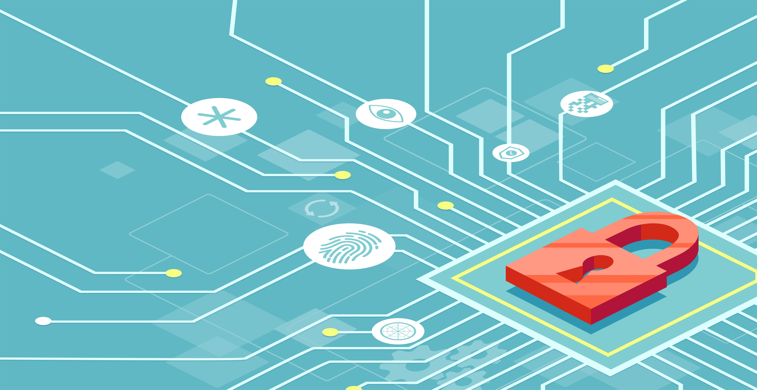
Defining the problem

Slide 5
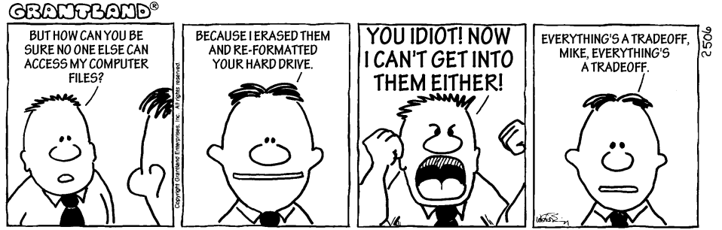
Accessibility vs. security
For many UX and accessibility professionals in fintech, health care, and other industries that need to collect sensitive personal information through web forms, we’re used to the security trump card.
Notes:
Tori: A common problem that UX and accessibility professionals face is security professionals who think that saying “no” to a feature that they deem even slightly insecure or removing an existing feature that are worried could cause vulnerabilities. But it’s illogical, irrational and – well – even illegal to remove functionality that provides accessibility to disabled users.
But removing or blocking certain features is like arguing “The key on the door lock could be duplicated or someone could pick it – so we might as well not have a door at all. It’s too risky.” That’s fine and there’s even some logic in that argument, but you won’t see me crawling through windows to get access to my house anytime soon.
In particular, a project you worked on had an issue arise regarding how to handle masking a field for SSNs and ITINs.
Richard: [explain Gateway]

Slide 6
Most security is superficial
Character masking in form fields is largely performative.
It’s only legally required for hiding sensitive information from workers who use different types of sensitive personal information.
For password fields that have 2FA (two-factor authentication), it only makes it harder for users to setup and remember passwords when masked.
Over-the-shoulder and other cybersecurity issues used to support the need for character masking are far less frequent than other types of cybersecurity threats.
Notes:
[Richard to share this slide]

Slide 7



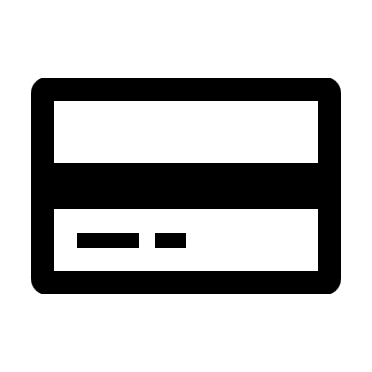




Disabled people deserve both accessibility and security
Accessibility professionals need to learn more about cybersecurity risks and how it impacts accessibility. Unless we understand the risks, we cannot advocate for disabled users.
Security professionals need to understand that no access or difficult access is not a synonym for secure.
Notes:
Richard: Not a matter of compromise but collaborate

Slide 8
What are the rules?
Notes:
Tori to start

Slide 9
What is sensitive information?
Forms of Identification
SSNs/ITINs
Financial Information
Credit cards
Driver’s license
Login Credentials
Health Information
Passwords
State IDs
Bank accounts
CVV
Security questions
Demographics
Medical history
Test results
Notes:
There are multiple different types of sensitive or confidential information, including but not limited to:
Forms of identification, such as Social Security Numbers (SSNs), Individual Taxpayer Identification Numbers (ITINs), driver’s licenses, and state IDs
Financial information, like Credit card numbers, bank account numbers, and CVV (Card Verification Values)
Login information, like passwords and security questions
Health information, including demographics, medical history, test results, and much, much more

Slide 10
What are the laws?
Federal
State
Gramm-Leach-Bliley Act:
Financial Privacy Rule
Safeguards Rule
Health Insurance Portability and Accountability Act (HIPAA)
Federal Information Security Management Act (FISMA)
California
Massachusetts
New York
Hawaii
Maryland
North Dakota
Notes:
The Financial Privacy Rule requires financial institutions to provide each consumer with a privacy notice at the time the consumer relationship is established and annually thereafter. The privacy notice must explain: 1) what information is collected 2) where that information is shared 3) how that information is used 4) how that information is protected.
The Safeguards Rule requires financial institutions to develop a written information security plan that describes how the company is prepared for, and plans to continue to protect clients' nonpublic personal information.
1) Constructing a thorough risk analysis on each department handling the nonpublic information,
2) Develop, monitor, and test a program to secure the information, and
3) Change the safeguards as needed with the changes in how information is collected, stored, and used.
HIPAA: There are 18 identifiers that can be used to identify, contact, or locate a person. If health information is used with any of these identifiers it is considered identifiable. If PHI has all of these identifiers removed, it is no longer considered to be protected health information. These include: Name, phone numbers, SSN, geographical identifiers, and more.
https://www.hipaajournal.com/what-is-protected-health-information/

Slide 11
What other guidelines are out there?
PCI Compliance
FFIEC
Governed by a council made up by major credit companies that wanted to reduce credit card fraud
Stands for the Federal Financial Institutions Examination Council
Prescribes uniform principles, standards, and report forms for the federal examination of financial institutions, including security
Banks must have internal processes to check for and address new threats
Requirement 3.3
Mask PAN when displayed (the first six and last four digits are the maximum number of digits to be displayed), such that only personnel with a legitimate business need can see more than the first six/last four digits of the PAN.

Slide 12
What are the real security concerns?
Notes:
Richard to start

Slide 13
The most common cybersecurity threats
Cyber attacks / Denial of service
Social engineering
Portable device loss
Unintended disclosures
Other factors
Low threat: Shoulder surfing/over the shoulder (no stats or studies)
Notes:
Stress we are not security professionals. We merely wanted to see how much of a threat not masking characters was. As a result, we couldn’t find statistics related to people looking over the shoulder of others .
Cyber attacks/Denial of Service = top cybersecurity threat. DoS is a cyber-attack in which the perpetrator seeks to make a machine or network resource unavailable to its intended users by temporarily or indefinitely disrupting services of a host connected to the Internet. Denial of service is to disrupt a business and may not have anything to do with identify theft. DDos or distributed denial of service is when the incoming traffic flooding the victim originates from many different sources.
Summary of data breach threats: “Follow the Data: Analyzing Breaches by Industry” (Trend Micro) Hackers are not looking for one person’s Personally Identifiable Information. They want thousands of people’s Personally Identifiable Information at once. In government sector. the most probable breach methods for stealing Personally Identifiable Information were loss or theft, unintended disclosures, hacking or malware attacks, and insider threats. The top 3 breach methods used in the financial industry were loss or theft, hacking or malware attacks, and insider threats. The top 3 breach methods seen were hacking or malware attacks, loss or theft, and unintended disclosures. (https://documents.trendmicro.com/assets/wp/wp-analyzing-breaches-by-industry.pdf)
Social engineering:
More than 80% of breaches due to phishing--the end goal of which is often to convince users to install malware.
33% of breaches in 2019 included social attacks, 94% of malware was delivered via email (Verizon Data Breach Investigations Report (DBIR) 2019, https://www.phishingbox.com/news/phishing-news/verizon-data-breach-investigations-report-dbir-2019) 65% of attacker groups used spear phishing as the primary infection vector, 48% of malicious email attachments are Office files, 71.4% of targeted attacks involved the use of spear-phishing emails (Symantec Internet Security Threat Report (ISTR) 2019, https://www.phishingbox.com/news/phishing-news/internet-security-threat-report-irst-2019)
Spyware is a type of malware that records your activities. A keylogger records every keystroke you make on your computer’s keyboard. With this information, a hacker can work out your username and password for a range of sites without even seeing what comes up on the screen. (https://www.comparitech.com/blog/vpn-privacy/what-is-keylogger/)
Portable device loss - USB keys, portable drives, laptops, phones - accounts for around 50% of all breaches (ENISA Threat Landscape Report 2018 https://www.enisa.europa.eu/publications/enisa-threat-landscape-report-2018)
Unintended disclosures or human error accounts for more than 40% of breaches in healthcare. Includes email sent to wrong person, discharge instructions given to the wrong patient, or a server containing PHI accidentally left open to the public. (Beazley Breach Report 2017, https://www.beazley.com/documents/TMB/Insights/201710-beazley-breach-insight-healthcare.pdf) and 34% of organizations see careless or unaware employees as a vulnerability (EY Global Information Security Survey 2018 https://www.phishingbox.com/news/phishing-news/ey-global-information-security-survey-2018)
Other factors: Internet of Things, installing skimmers on ATMs and credit card readers
Shoulder-surfing/over-the shoulder attacks: According to 2017 Science Daily, there are no reliable statistics on prevalence of shoulder surfing . A search of the National Cyber Security Alliance (NCSA) site has no statistics. A 2016 study conducted by Memon and Nguyen found that 73 percent of mobile device users surveyed reported that they had observed someone else's PIN (although not necessarily with malicious intent) (https://www.sciencedaily.com/releases/2017/08/170822153610.htm) Security experts say that over-the shoulder attacks may also involve shooting a video of a person entering PII on phone or keyboard. IoT a hacker can use baby monitor cameras to observe people entering PII. They may also eavesdrop a person reciting a credit card in next cubicle. Ponemon Institute released report on visual hacking in office, but not concerned with just over the shoulder. White-hat hacker was able to visually hack sensitive information from a worker’s computer screen or hard copy documents. That information included, employee contact lists, customer information, corporate financials, employee access and login information, and credentials or information about employees. (https://multimedia.3m.com/mws/media/1254232O/global-visual-hacking-experiment-study-summary.pdf)
Ponemon Institute released report on visual hacking in office, but not concerned with just over the shoulder. White-hat hacker was able to visually hack sensitive information from a worker’s computer screen or hard copy documents. That information included, employee contact lists, customer information, corporate financials, employee access and login information, and credentials or information about employees. (https://multimedia.3m.com/mws/media/1254232O/global-visual-hacking-experiment-study-summary.pdf)

Slide 14
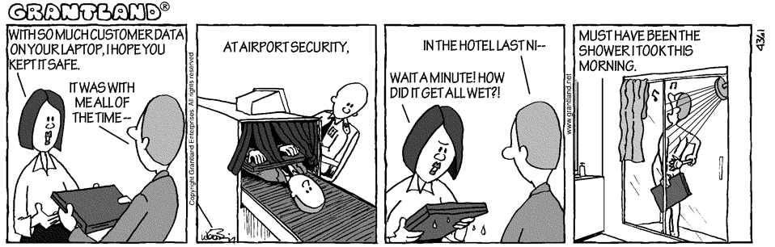
Cybersecurity theatre
disruption of service
main security threat
social engineering
main data breach threat
over-the-shoulder attacks
no reliable statistics
Notes:
Richard to speak about this slide

Slide 15
Implement real security
Other, better techniques for security should be used (and some are legally required):
2FA and/or biometrics
Proper encryption of data (which doesn’t affect character masking for *users* and is legally required)
Education and training for employees that use/deal with sensitive information of customers/clients as part of their job

Slide 16
Should certain fields even be masked?
Most people have poor password hygiene, and create weak passwords, reuse passwords, and rarely or never change those passwords.
However, user choice is key. What about screen magnification users who don’t want a giant example of their SSN out there, or those who are blind and might not be able to tell an over-the-shoulder attack?
2FA is an excellent way to improve security, since passwords shouldn’t be the end-all-be-all
Notes:
Richard:
The Costs of Masking. Password masking has proven to be a particularly nasty usability problem in our testing of mobile devices, where typing is difficult and typos are common. But the problem exists for desktop users as well. When you make it hard for users to enter passwords you create two problems — one of which actually lowers security:
Users make more errors when they can't see what they're typing while filling in a form. They therefore feel less confident. This double degradation of the user experience means that people are more likely to give up and never log in to your site at all, leading to lost business. (Or, in the case of intranets, increased support calls.)
The more uncertain users feel about typing passwords, the more likely they are to (a) employ overly simple passwords and/or (b) copy-paste passwords from a file on their computer. Both behaviors lead to a true loss of security. Stop Password Masking, Jakob Nielsen (https://www.nngroup.com/articles/stop-password-masking/)
The inherent problem with data security is human fallibility. Even with the most advanced security systems in place, if there is a human component to that system,
there will be vulnerabilities. People create weak passwords, reuse these passwords across multiple sites, share information on social networks and inadvertently
click on phishing links that download malware or viruses. (https://www.csid.com/wp-content/uploads/2012/09/CS_PasswordSurvey_FullReport_FINAL.pdf and https://cxl.com/blog/password-ux/)

Slide 17
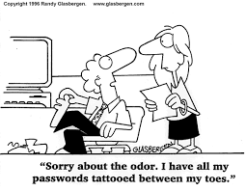
Education is the best defense for users
People are using weak passwords or reuse them
Privacy filters for public places – or just don’t do stuff on public internet!
Proper firewalls/virus protection
Understand phishing and other security risks to avoid like keylogging software, etc.
Notes:
Weak Passwords: The inherent problem with data security is human fallibility. Even with the most advanced security systems in place, if there is a human component to that system,
there will be vulnerabilities. People create weak passwords, reuse these passwords across multiple sites, share information on social networks and inadvertently
click on phishing links that download malware or viruses. (https://www.csid.com/wp-content/uploads/2012/09/CS_PasswordSurvey_FullReport_FINAL.pdf and https://cxl.com/blog/password-ux/)
Unless we rethink how we verify our identities, experts say, we’ll just keep falling victim to breaches. That starts with Social Security numbers, which have turned into a vital — but vulnerable — method of authentication. The Social Security number — created in 1936 to track Americans’ social benefits — was never meant to be a form of identity verification. “It literally said it on the card,” says Stickley. “For Social Security purposes — not for identification.” But that line disappeared in the mid-1970s, and the single identifier proved convenient when it came time for the U.S. to handle information using computers. Since then, Americans have been using their “social” for everything from applying for a credit card to filing their taxes online. (https://time.com/5643643/capital-one-equifax-data-breach-social-security/)
Privacy filters: There are physical filters—pieces of plastic basically—that people can put on their computer screens or phones. According to a 2016 report by 3M, some 80% of the 1,000 business travelers surveyed worldwide said they consider visual hacking to be a threat. However, many are not doing anything to fight against it, the report found. 3M produces products to put on your screen to help prevent side viewing. (https://www.3m.com/3M/en_US/privacy-screen-protectors-us/expertise/visualhacking/)
Proper firewalls/virus protection/phishing and understanding it and other risks: We are not security experts, but after doing some research learned that human error firewall misconfigurations are responsible for some system breaches. Adoption of cloud and mobile technologies has significantly expanded the attack surface. Phishing attacks through email is a dominant factor in data breach attacks. The most recent trend has been an increase in ransomware attacks as per stats in the 4th quarter 2019. Ransomware can be spread through methods such as phishing, malicious attachments and links in emails, macro enabled emails, social media, instant messaging, and leaving web servers unprotected.
Many employees fail to apply basic security techniques, in particular reusing passwords, and using their business devices for personal purposes, often on their unprotected home networks
Network professionals may fail to employ a data backup and recovery plan for all critical information, update OS and software, updating anti-virus software, restrict employees’ ability to install software, block malicious websites from employees

Slide 18
How does character masking affect accessibility?
Notes:
Richard continues

Slide 19
Three masking patterns in the wild
No ability to unmask
Unmasked on focus
Show-hide functionality (button, switch, or checkbox)

Slide 20
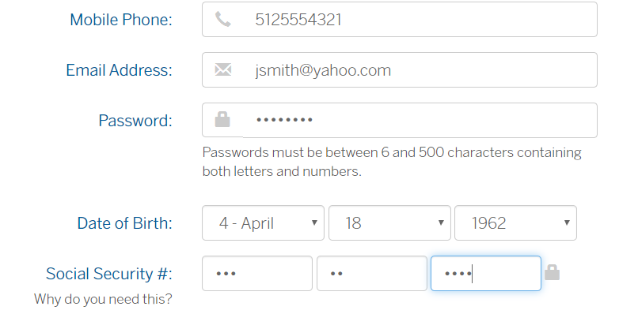
Pattern 1: No ability to unmask

Slide 21
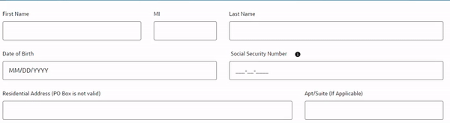
Pattern 2: Unmasked on focus

Slide 22
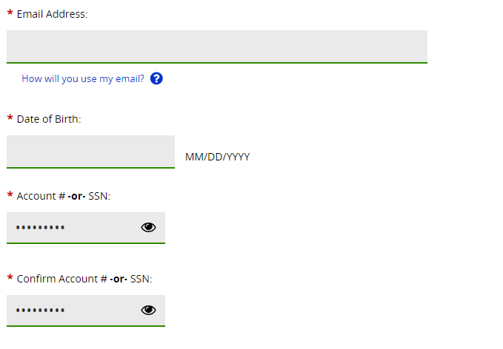
Pattern 3: Show-hide functionality

Slide 23
Beyond simple semantics and labels
Simple Semantics and Labels
Identifying Input Purpose
Form fields must have programmatic labels associated with the form field, as well as a contrast compliant-visible label. Also…don’t create multiple inputs for a singular value!
Related Criteria:
1.3.1 Info & Relationships
2.4.6 Headings & Labels
3.3.2 Labels or Instructions
When possible, the form field should specify input purpose using both the type and autocomplete attribute.
type=“password”
autocomplete=“current-password”
Related Criteria:
1.3.5 Identify Input Purpose
Notes:
Tori to start
WCAG 3.3.1 Error Identification: If an input error is automatically detected, it is identified and described to the user in text.
WCAG 3.3.3 Error Suggestion: If an error is automatically detected and suggestions for corrections are known, then it should be provided to the user, unless it would jeopardize user security
WCAG 3.3.4 Error Prevention (Legal, Financial, Data) // WCAG 3.3.6 Error Prevention (All): Submissions must be reversible, checked for errors (if applicable), and/or confirmed.
Examples: Secondary confirmation input, Confirmation page

Slide 24
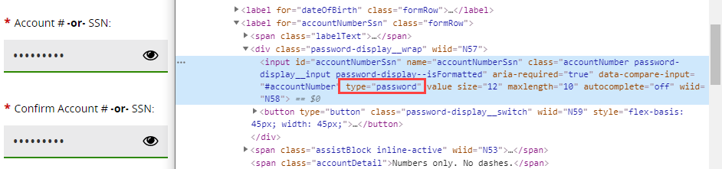
Identify Input Purpose, purposefully
Don’t use type=“password” as a masking technique
For password fields, use both type and autocomplete attributes to empower autofill, including current-password, new-password, and one-time code
Notes:
Tori to start

Slide 25
Understanding WCAG error risks
WCAG 3.3.1 Error Identification: If an input error is automatically detected, it is identified and described to the user in text.
WCAG 3.3.3 Error Suggestion: If an error is automatically detected and suggestions for corrections are known, then it should be provided to the user, unless it would jeopardize user security
WCAG 3.3.4 Error Prevention (Legal, Financial, Data): Submissions must be reversible, checked for errors (if applicable), and/or confirmed.
Examples: Secondary confirmation input, Confirmation page
Notes:
Tori to start:
If characters are masked, whether by choice or not, input assistance becomes critical.

Slide 26
When does error prevention apply?
Legal Commitments
Validating personal info on forms like background checks or loan applications
Financial Transactions
Rarely a problem − Most verify full name, credit card/account number, CVV, and address before submission
User-controllable Data
Health Information
Passwords
Security Questions
Demographics
Medical History
Test results

Slide 27
What the font icon?
Not all masking techniques are created equal, and masking techniques that may be fine for non-disabled users may increase security risk for disabled users.
Some users override fonts to use a font that’s easier to perceive like OpenDyslexic, Atkinson Hyperlegible, or Arial. Certain masking techniques leverage font icons for a superficial masking, but this will expose the characters for those using custom fonts.
Other techniques that leverage methods that mask superficially (e.g., through visually hidden text) will also expose characters announced by screen readers.

Slide 28
What do the users say?
Notes:
Tori to continue

Slide 29
User study overview
13 took it in spring 2020, but we’re always looking to hear from more! Bit.ly/charmasking

Slide 30
Security concerns & masking preferences

Slide 31


Feedback on the solutions
Users find show/hide better due to familiarity, user choice, and security (esp. for blind and low vision users) in whether to expose data.
It allows me to have control of the show/hide. I might be at home and don't care who sees the info or I might be on public transit and want to make sure that the info can't be seen by prying eyes.
I like the ability to show what I typed so that I can make sure it's accurate. I often turn numbers around by accident due to cognitive issues, so it's nice to double-check.

Slide 32
Autofill usage
Many security professionals claim that autocomplete=“off” and preventing copy-paste is “more secure”, but this only increases the likelihood that someone will need to ask for help and unintentionally expose their data.

Slide 33
The Solution title
Notes:
Richard to start

Slide 34
The Solution
Use show-hide functionality
Allow autofill and pasting
Provide timely instructions and clear & concise error messaging
Offer a way to reverse or confirm potential user errors
Start with semantics

Slide 35
Step 1: Start with semantics
<form aria-labelledby=“form-name”>
<h2 id=“form-name”>Personal
Info</h2>
[…]
<fieldset>
<legend>Type and confirm your
SSNs</legend>
<label for=“ssn”>Social Security
Number>
<input id=“ssn”>
<label for=“ssn-confirm”>Confirm
your SSN</label>
<input id=“ssn-confirm”>
</fieldset>
</form>
Use semantic labels and inputs that are associated, ideally within a <form> element
If using a confirmation field, group the original input and confirmation in a <fieldset>
If using an acronym, expand the acronym for screen reader users using aria-label or another technique

Slide 36
Step 2: Use show-hide functionality
Show-hide should be the standard rather than unmasked on focus:
User choice
Security for at-risk disabled populations
Familiarity
Notes:
However, user choice is key. What about screen magnification users who don’t want a giant example of their SSN out there, or those who are blind and might not be able to tell an over-the-shoulder attack?

Slide 37



Button, switch, or checkbox?
Button
Most common pattern found in our travels
Our recommendation, when considering backwards compatibility
Switch
Role=“switch” meant for checkbox or toggle button per ARIA 1.1
Checkbox
Better than nothing, but is not an expected user experience
Checkbox is an older pattern, although some still use it
While support is better, there is still not wide screen reader support
Notes:
Can be used on <button>, but was initially intended for checkbox

Slide 38
Additional considerations for show-hide
Use text in place of or in addition to icons for show-hide button/switch so that speech recognition users don’t have to guess the accessible label
Place the show-hide button ahead of the input in the DOM and focus order, so users can choose before getting to the form field
Add an aria-live section that announces whether the password has been shown or hidden after activating the button or switch

Slide 39
Step 3: Allow autofill and pasting
Allow autofill through autocomplete attributes and additionally leverage type attributes when appropriate
Autofill shouldn’t be considered a “fix” to then allow full masking with no ability to unmask
Allow copy/paste into fields so people can use password keepers, autofill for credit card information, etc.
Notes:
Tori to start

Slide 40
Step 4: Provide timely instructions and clear & concise error messaging
If there are password requirements, provide them ahead of the form fields, and programmatically associate the instructions with the inputs for screen reader users.
Instructions should not be used alone. Error suggestions for incomplete password requirements should still be supplied.
For sensitive form fields with a specific character requirement, provide error messaging specific to missing or extra digits.

Slide 41
Step 5: Offer a way to reverse or confirm potential user errors
Note: This is only required for forms that cause legal commitments, financial transactions, modify or delete user-controllable data, or submit user test responses.
Provide one or more of the following techniques:
Confirmation page with ability to edit or go back
Confirmation form fields (i.e., retyping password or email)
Checkbox verifying the user checked all fields (not ideal)
An option to reverse a submission after the fact

Slide 42
Looking Ahead & Further Reading

Slide 43
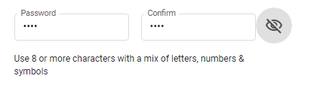
How can we extend these patterns?
Future versions of HTML may extend the types of autocomplete attributes to cover more use cases
Using a joint toggle button or switch rather than one each for original and confirmation input fields in a fieldset (e.g., for passwords)

Slide 44
References & Further Reading, 1 of 3
“Show/Hide Password Accessibility and Password Hints Tutorial,” Nicolas Steenhout (web retrieved 5/15/2021)
“Should you use ‘Confirm Password’ on your forms and websites?: A Case Study” Zuko.io, formerly Formismo (web retrieved 5/15/2021)
“Cybercrime and The Internet Of Threats 2019,” Juniper Research (web retrieved 5/15/2021)
“Future Fraud ~ 3 Dynamics Changing Fraud in 2019,” Juniper Research (web retrieved 11/20/2019)
“Global Visual Hacking Experimental Study: Analysis,” 3M (web retrieved 5/15/2021)
“New Study Exposes Visual Hacking Is A Global Problem,” 3M (web retrieved 5/15/2021)

Slide 45
References & Further Reading, 2 of 3
“2019 Internet Security Threat Report from Symantec™,” (web retrieved 5/15/2021)
“The disabled community is the world’s third-largest economic power,” Quartz (web retrieved 5/15/2021)
“Tapping into an easy $6.9B in annual revenue; 3 things to learn from Amazon,” Deque (web retrieved 5/15/2021)
“Security Think Tank: Balancing data accessibility with security controls,” Computer Weekly (web retrieved 5/15/2021)
“Stop Password Masking,” Nielsen Norman Group, (web retrieved 5/15/2021)

Slide 46
References & Further Reading, 3 of 3
“Masked passwords, security questions, captcha and other unusable security,” Agris Alksnis (web retrieved 5/15/2021)
“Blurring The Lines Between Usability and Security — Spectranet Case,” Oluwatobi Akindunjoye (web retrieved 5/15/2021)
“Remove password masking,” Jack Holmes (web retrieved 5/15/2021)
“Data Masking: An Introduction,” Stephen Watts, BMC (web retrieved 5/15/2021)
“The Pros and Cons of Password Masking,” Bruce Schneier (web retrieved 5/15/2021)

Slide 47
Thank you!
Thank you!

